Slide 1
Social Evolution and Multilevel Selection
Dr. Simon T. Powers
stp2@ecs.soton.ac.uk
Science & Engineering of Natural Systems Group

Slide 2
Lecture Overview
What is social evolution?
Social Dilemmas and the “Tragedy of the Commons” – why individual selection favours the selfish.
Old style group selection: “for the good of the species”.
Modern multilevel selection.
Dawkins – “Isn’t all selection for the good of the gene?”
Group selection is central to the Major Transitions.

Slide 3
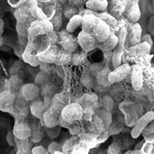
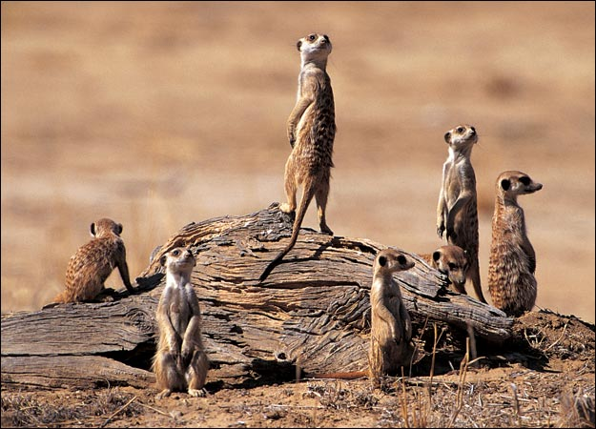
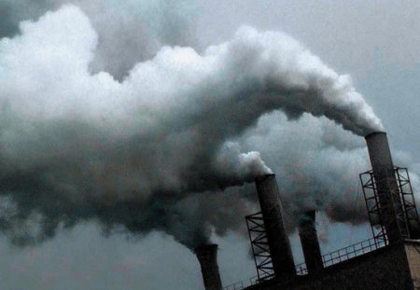
What is Social Evolution?
All organisms live with others and so have social interactions: they affect each others fitness…
…from bacteria, to humans, to the cells within your body.

Slide 4
How do Non-Social Traits Evolve?
In traditional models of natural selection, a heritable trait that gives its bearer an advantage over others, e.g., good eyesight, increases in frequency in the population.
The trait gives an advantage relative to others in the same population.
As they spread, the mean fitness of the population also increases.
So, what is good for the individual is good for the population.

Slide 5
What’s Different with Social Traits?
Social traits affect the fitness of others.
Natural selection works on relative fitness.
So a spiteful trait that decreases the fitness of other population members could spread, e.g., chemical warfare by bacteria.
Thus, natural selection on social traits can decrease mean population fitness…
… even to the point that the population is driven extinct!

Slide 6
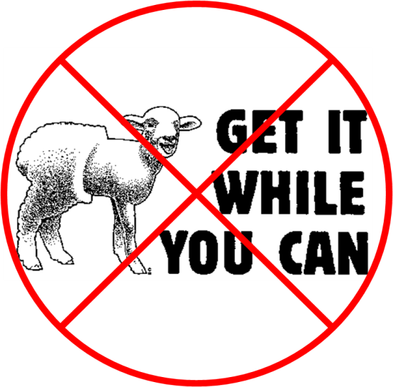
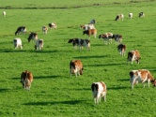
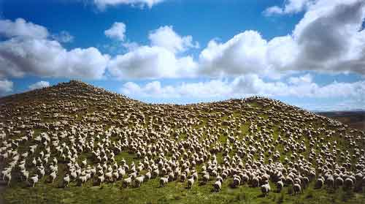
Social Dilemmas and the Tragedy of the Commons

Slide 7
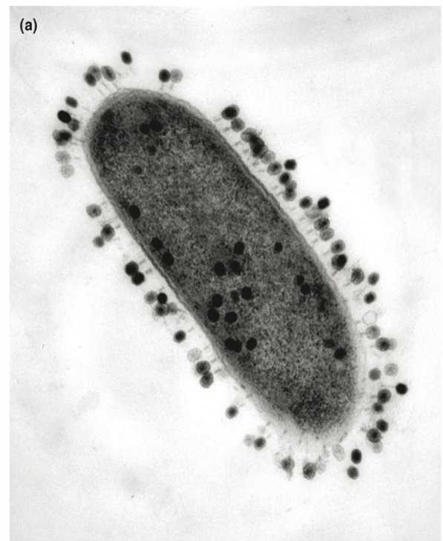
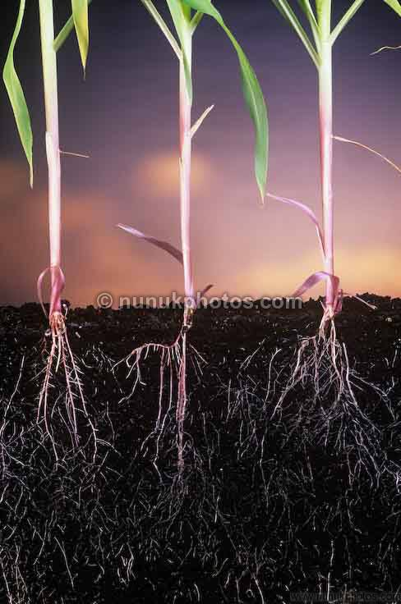
Biological Examples of Resource Consumption Tragedies
Trade-off of consumption rate vs. yield from a resource: selfish, inefficient, resource users take over.
Virus phages exploiting a host bacteria.
Plant roots competing for water.

Slide 8
Public Goods Production
Social dilemmas also occur with the production of public goods.
Public goods are those produced by one individual, but that benefit the whole group.
But, they typically carry a cost to produce.
Why should one individual help the group, if it costs them personally?
Notes:
Green microbes are anthrax, other microbers are their siderophores. Other image is a vervet monkey.

Slide 9
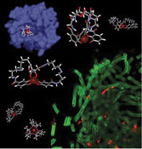
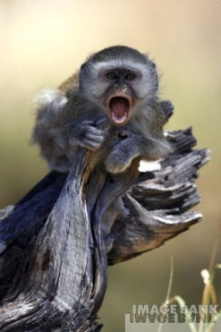
Examples of Public Goods Production
Siderophore production by anthrax.
Predator alarm calls by vervet monkeys.

Slide 10
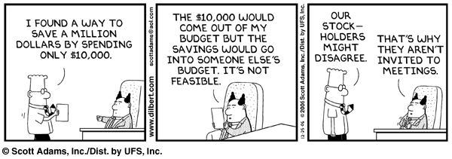
Selfish Non-Producers are Favoured
Problem: the benefit is shared, but only the producer pays the cost.

Slide 11
How might the Tragedy of the Commons be avoided in Humans?
Taxes and other centralised policies to promote cooperation, e.g., tax on car fuel to reduce pollution.
These change the individual costs and benefits of cooperating.
Another mechanism is private ownership of the “commons”.

Slide 12
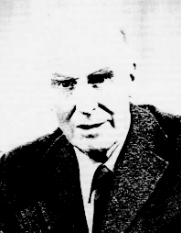
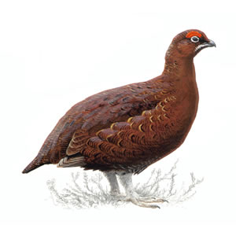
How does Natural Selection Resolve the Tragedy?
Cooperation over public goods consumption or production does not always break down in other species.
First (unrefined) answer: groups have adaptations which prevent the tragedy, e.g., ritual displays to avoid costly fights.
The classic example: V. C. Wynne-Edwards (1962) claimed that populations of red grouse in Scotland limited their breeding, to avoid overexploiting resources.

Slide 13
How would Breeding Restraint Work?
Wynne-Edwards thought natural selection acted between populations of red grouse.
Populations which practised breeding restraint would survive, those without restraint would tend to go extinct by the tragedy of the commons.
So breeding restraint was an adaptation of populations.

Slide 14
Problems with this Explanation
A mutant that does not practise breeding restraint will be fitter – by definition it has more offspring!
So individual selection within populations favours unrestrained breeding.
Although selection between populations may favour restraint, individual selection is typically assumed to be stronger (faster generation times of individuals, greater genetic variance between individuals than populations…)
So individual selection beats population-level selection.

Slide 15
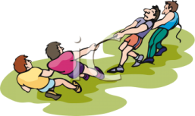
Multilevel Selection
Selection acts within and between groups simultaneously (c.f. D.S. Wilson and E. Sober).
Whether the tragedy of the commons is averted depends on a tug of war between these selective forces.

Slide 16
Group Selection can also Win
GLOBAL POPULATION
GROUP FORMATION
REPRODUCTION & INDIVIDUAL SELECTION
DISPERSAL & GROUP SELECTION
GROUPS RE-DISPERSE
‏
Average change in proportion of selfish individuals over time within each group
Change in global proportion of selfish individuals over time.

Slide 17
What is Needed for Group Selection to Win?
In the 1960s, theorists thought within group selection would always win.
Selection at any level needs heritable variation in fitness at that level.
Between-group selection wins if the (genetic) variance between groups is greater than that within groups (the Price Equation).

Slide 18
Variance Between Groups
Need cooperative individuals to be clustered into the same groups.
Then most of the variance will be between groups.
Intuitively, the benefits of cooperation will then fall upon other cooperators, rather than upon selfish “cheats”.

Slide 19
Dispersal and Between-Group Variance
Also, to maintain between-group variance, the groups must periodically be reformed.
Why? Because selfish individuals still increase in frequency within each group, and so would still ultimately reach fixation.
That is, individual selection within groups reduces any initial between-group variance.
This can be avoided if groups are regularly reformed.

Slide 20
What Sort of Groups might have High Between-Group Variance?
Unlikely in whole populations, like the red grouse considered by Wynne-Edwards.
Groups might be formed assortatively – cooperators seek each other out.
Or, if groups are founded by only a few individuals sampled at random from the global population, then variance will be high.
Family groups also give high between-group variance, e.g., siblings in a nest.

Slide 21

Reinterpretations: Kin Selection
Hamilton explained cooperation by kin selection.
If the benefits of cooperation fall on relatives, then an individual cooperator is helping other copies of its own genes.
Hamilton’s rule: relatedness * benefit > cost
Seems to avoid group selection, but is actually an instance of it.

Slide 22
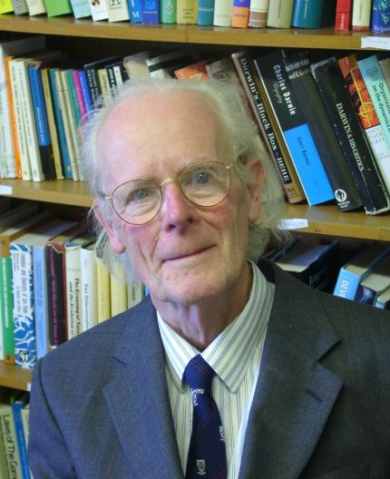
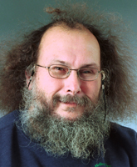
Reinterpretations: Individual Selection
Can view the group as the context in which individual selection occurs.
When cooperation evolves, individuals that cooperate must increase in frequency.
So can say that it is individually advantageous to cooperate in some group-structured populations.
Thus, only need to monitor the frequency of individuals, not groups.

Slide 23
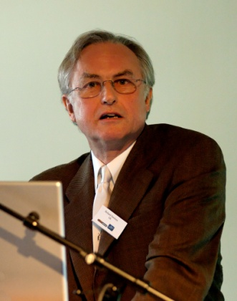
The Selfish Gene
When cooperation evolves, the genes that influence it must increase in frequency.
So can say all selection “is for the good of the gene”.
A useful rule of thumb to check the logic of evolutionary arguments, but seems empty.

Slide 24
Group Selection and the Major Transitions
Pre-transition | Post-transition
Replicating molecules on a surface | Replicators compartmentalised in cells
Unlinked replicators | Replicators physically linked on chromosomes
Prokaryotes | Eukaryotes
Single cells | Multicellular organisms
Solitary organisms | Eusocial colonies
A major transition occurs when within-group selection is suppressed, and between-group selection dominates (Michod, 1999).

Slide 25
Summary
The tragedy of the commons occurs when individually rational behaviour is detrimental to the group.
Examples include growing at a faster rate despite this reducing yield, and “cheating” by consuming public goods without producing them.
Individual selection favours selfish behaviour within groups.
But between-group selection favours cooperation.
A major transition occurs when within-group selection is suppressed, leaving between-group selection as the only effective evolutionary force.

Slide 26
Bibliography
Wynne-Edwards, V. C. (1962). Animal Dispersion in Relation to Social Behaviour. Oliver and Boyd.
Hamilton, W. D. (1964). The genetical evolution of social behaviour I and II. Journal of Theoretical Biology, 7:1-52.
Hardin, G. (1968). The tragedy of the commons. Science, 162:1243-1248.
Sterelny, K. (1996). The Return of the Group. Philosophy of Science, 63(4):562-584.
Maynard Smith, J. (1998). The origin of altruism. Nature, 393:639-640.
Sober, E. and Wilson, D. S. (1998). Unto Others: The Evolution and Psychology of Unselfish Behavior. Harvard University Press, Cambridge, MA.
Michod, R. E. (1999). Darwinian Dynamics: Evolutionary Transitions in Fitness and Individuality. Princeton University Press.
Okasha, S. (2006). Evolution and the Levels of Selection. Clarendon Press.

Slide 27
Social Evolution in the 1960s
Group selection assumed to always loose out to individual selection.
But, cooperation in social dilemmas did occur in nature, so still needed an explanation:
  1. Cooperation is actually individually advantageous.
  2. Kin selection

